Slide 1
Welcome to Turn Up the STEAM!
This presentation will share Early Math Project and Early Math Initiative videos, games, activities, and literature reviews. We will look at ways these resources can be used to support family engagement.
While we wait for all participants to join us,
please take this time to gather 20 different
small objects (these can be anything!) for
an upcoming activity.
2021

Slide 2
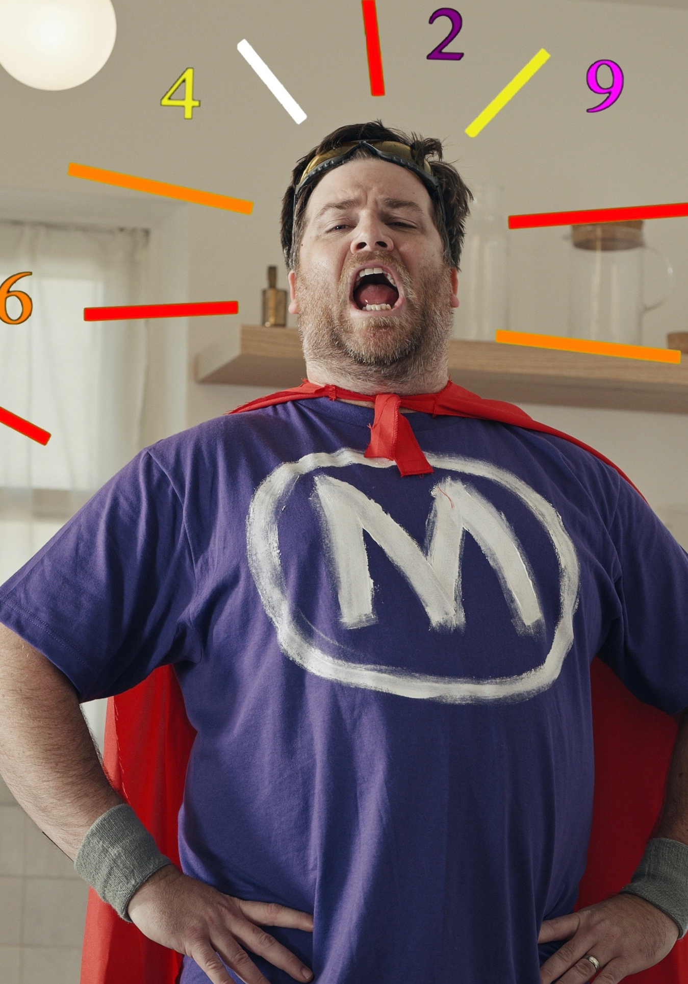
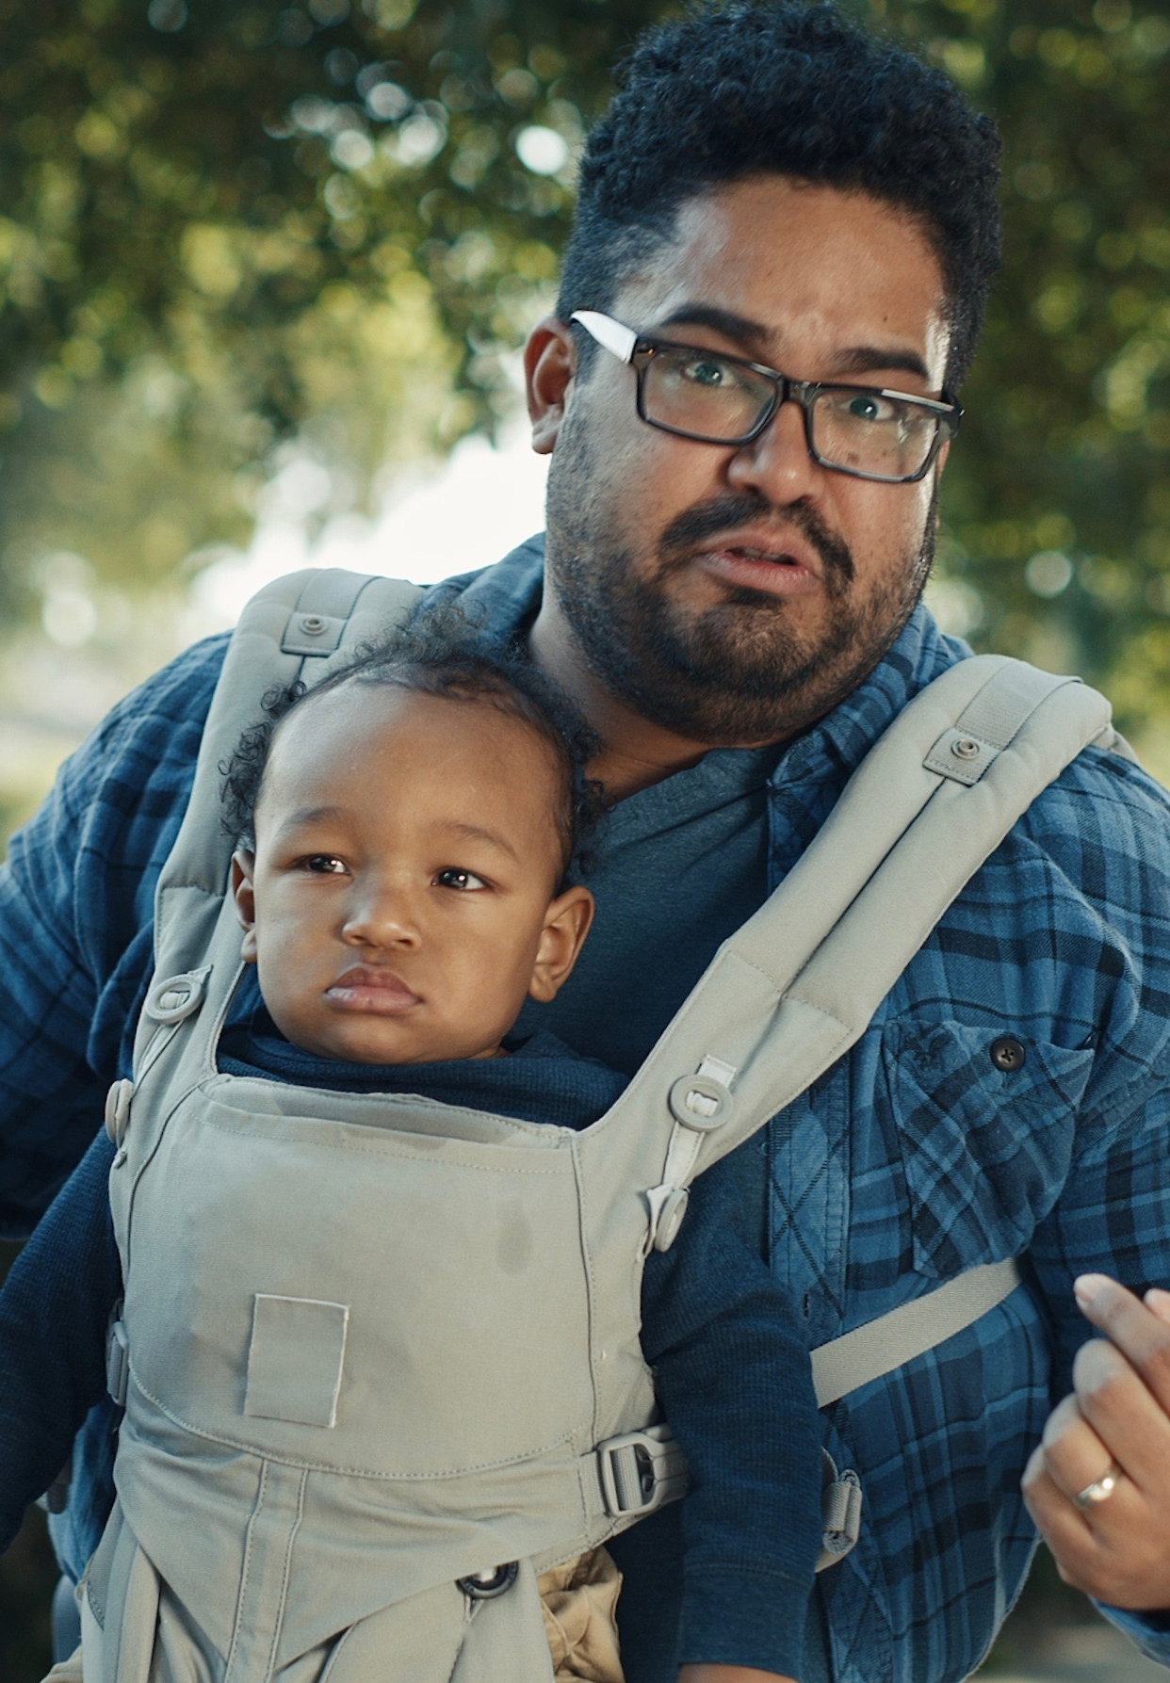
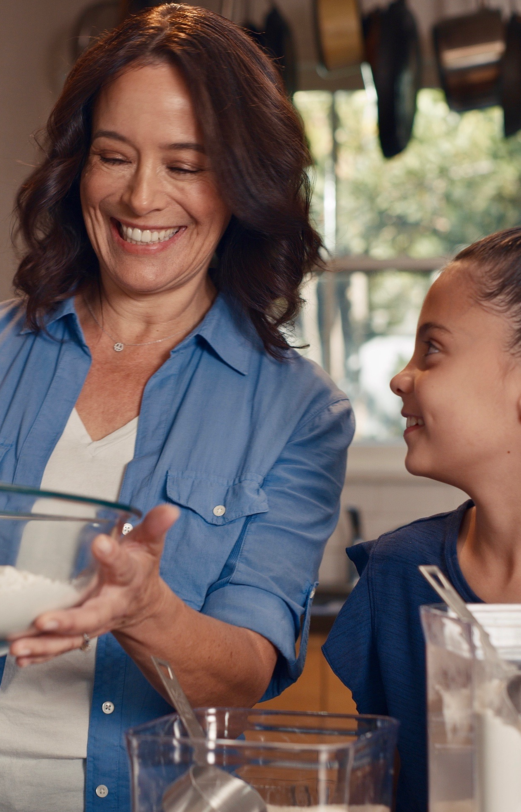
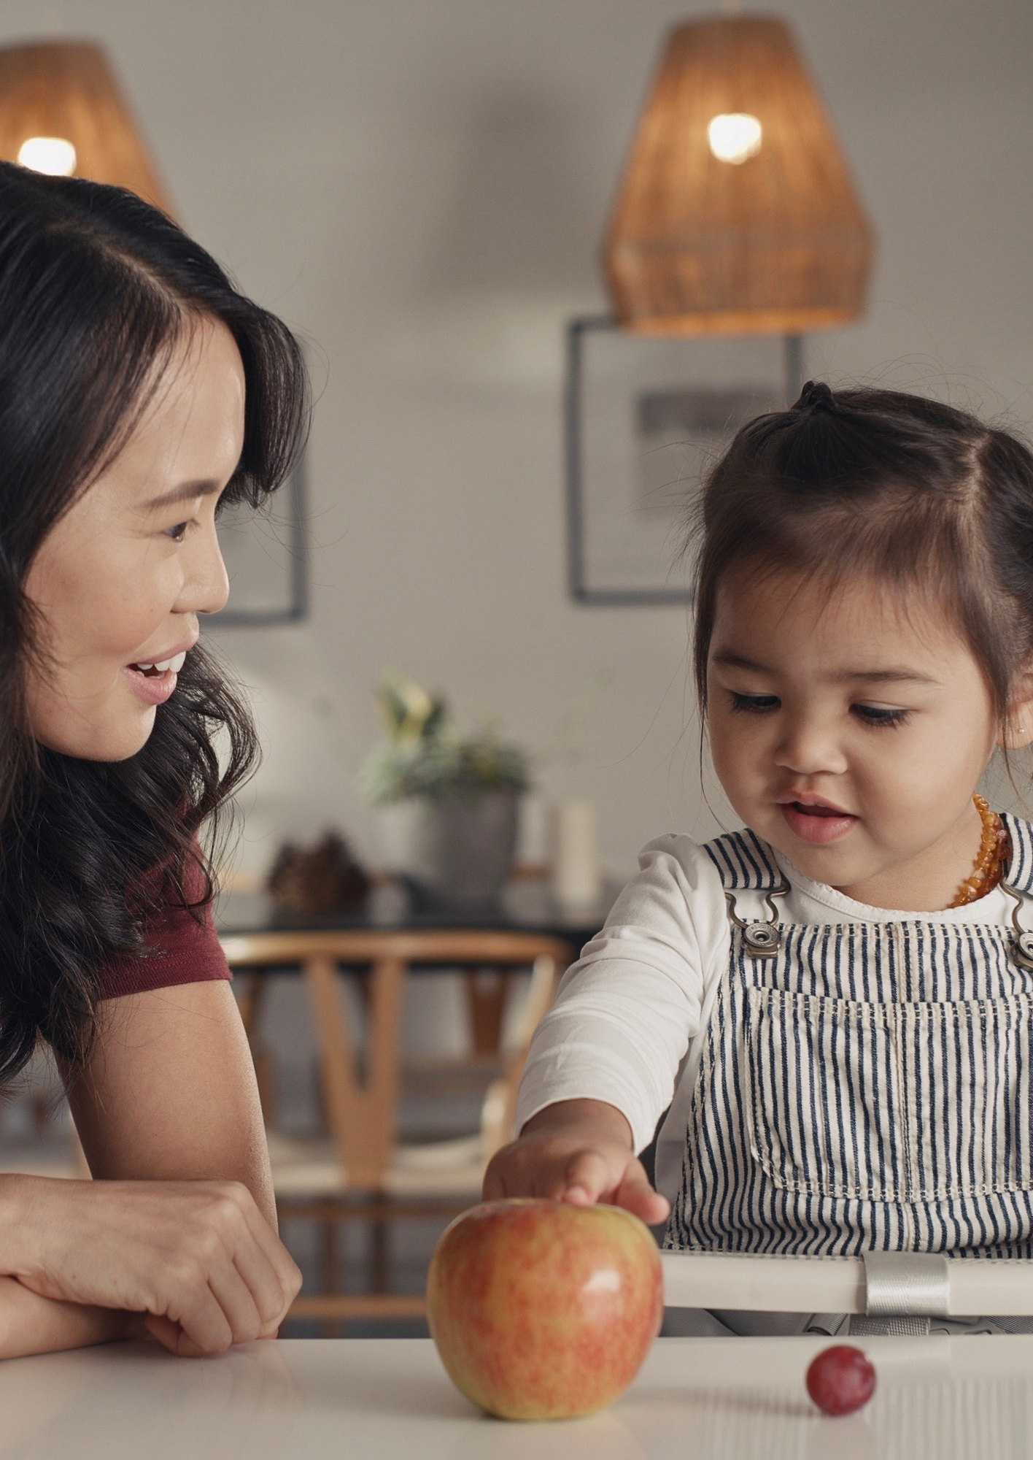
Turn up the STEAM: Family Engagement
Early Math Project
2021

Slide 3
Who we are:
Early Math Project
2021
Notes:
with questions or ideas about any of the information or resources shared in this presentation today.

Slide 4
EMP and Initiative
Resources
Early Math Project
2021

Slide 5
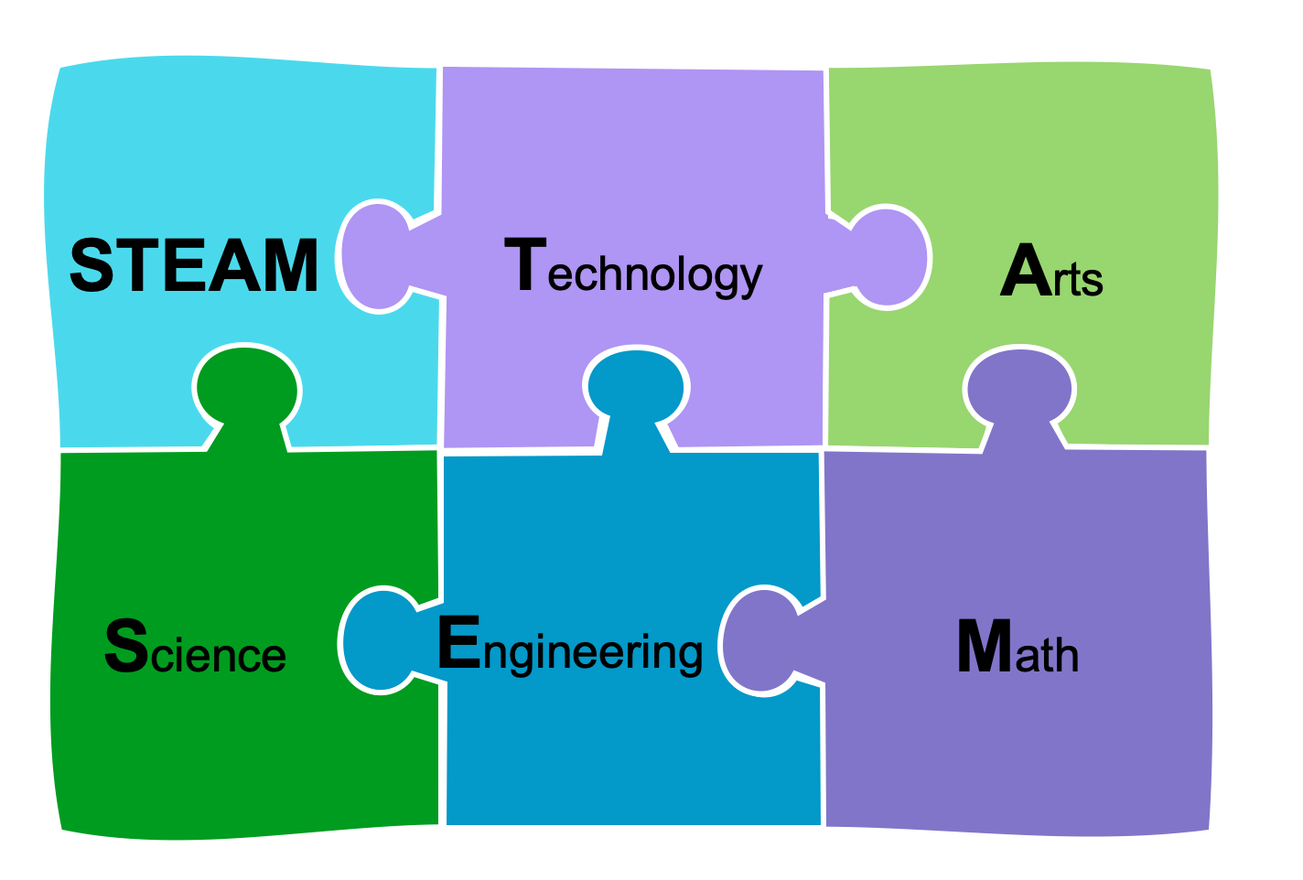
How it all fits together
2021
Early Math Project

Slide 6
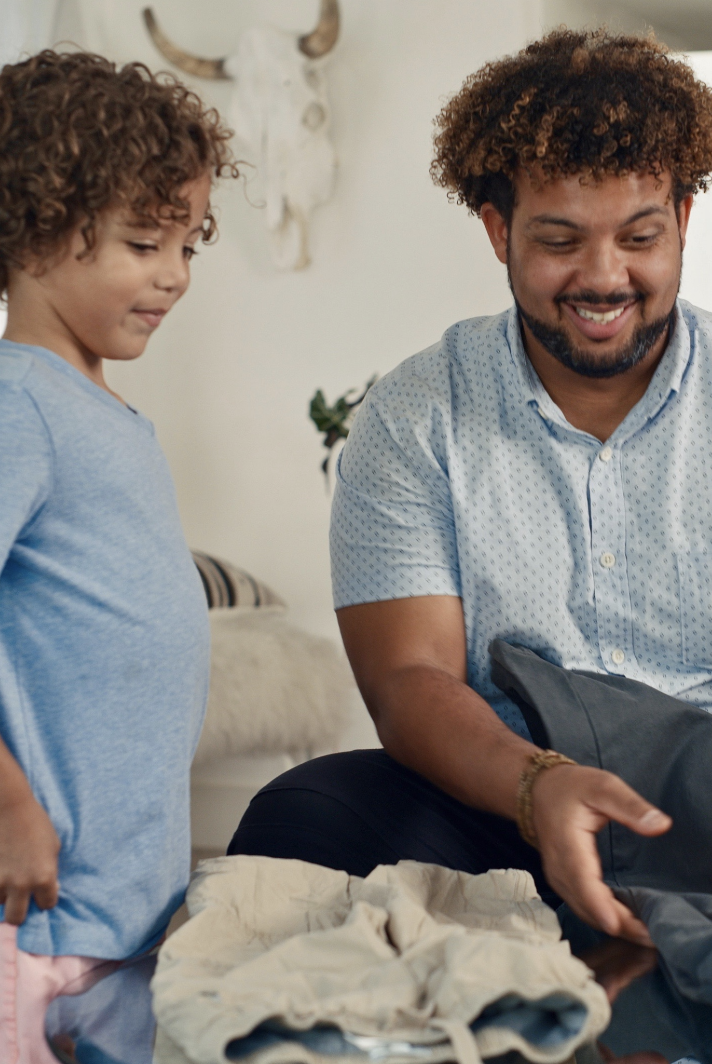
I’m Ready Videos!
So much learning at laundry time!
Sorting
Counting
Positional Words
Classification
Math talks
I’m Ready! Videos available on Count Play Explore Application and www.earlymathca.org
Early Math Project
2021

Slide 7
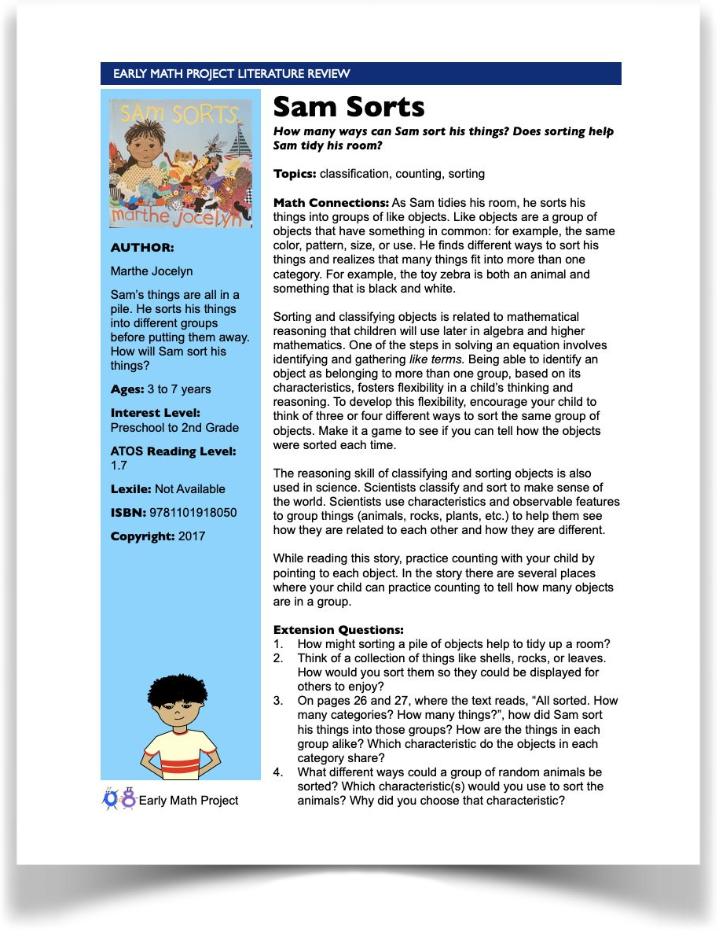
Literature Reviews
Math Topics/Connections
Activities
Extension Questions/Conversations
Vocabulary
Original Activities
Links to Online Resources
Early Math Project
2021

Slide 8
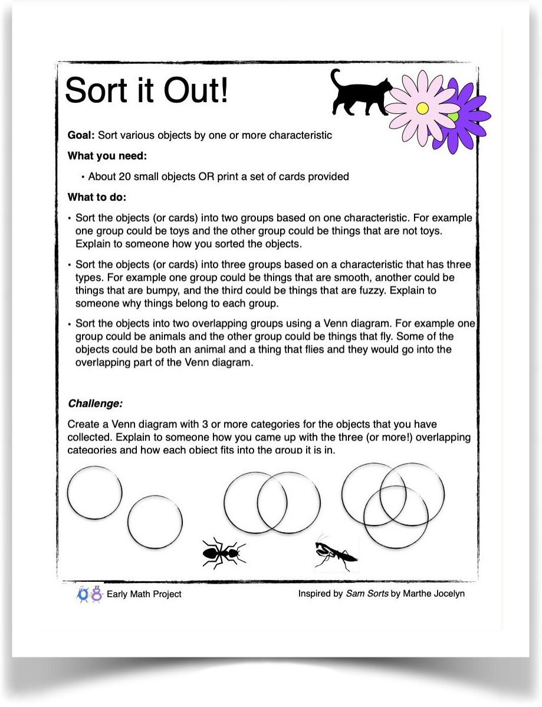
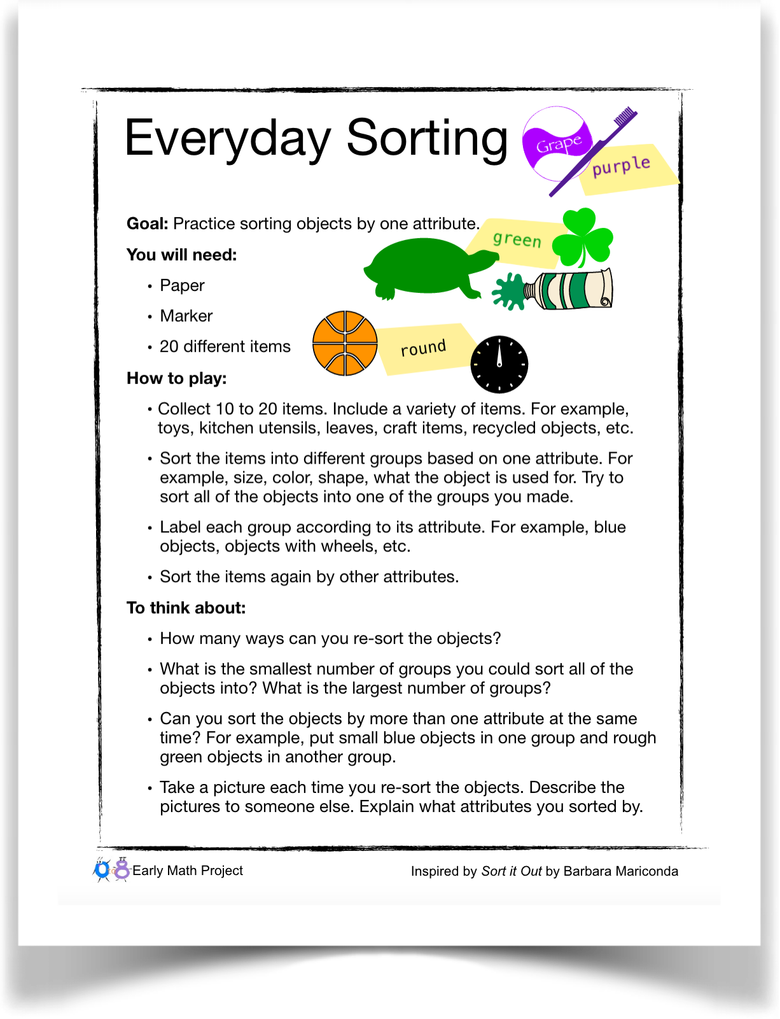
Activities
Early Math Project
2021

Slide 9
Count Play Explore Issues
Family engagement ideas to support counting, playing, and exploring
+
Investigations designed by Fresno County’s STEM Department
Early Math Project
2021

Slide 10
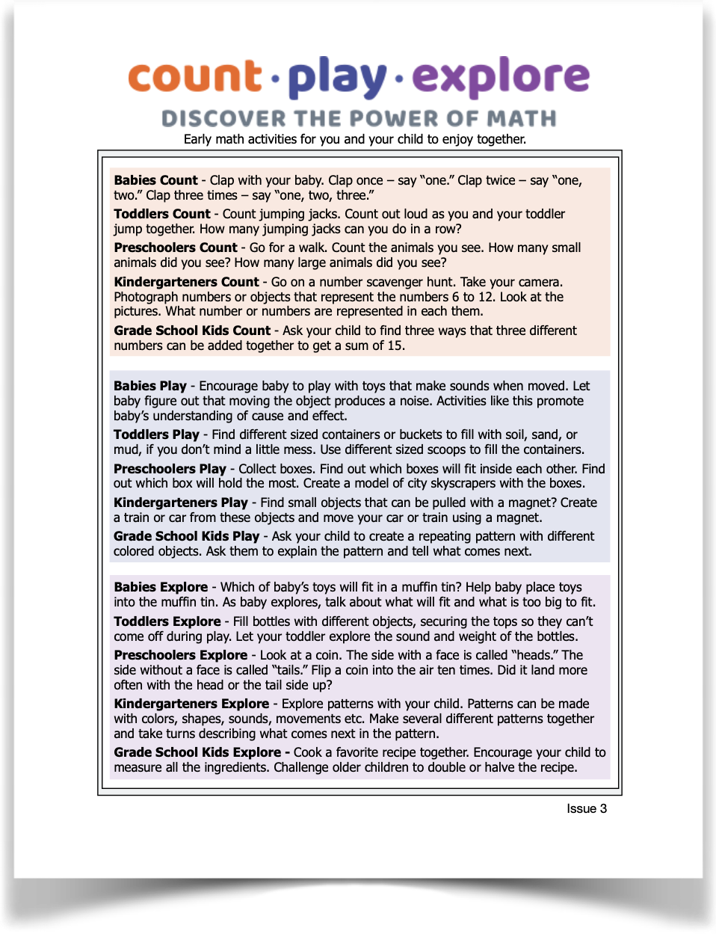
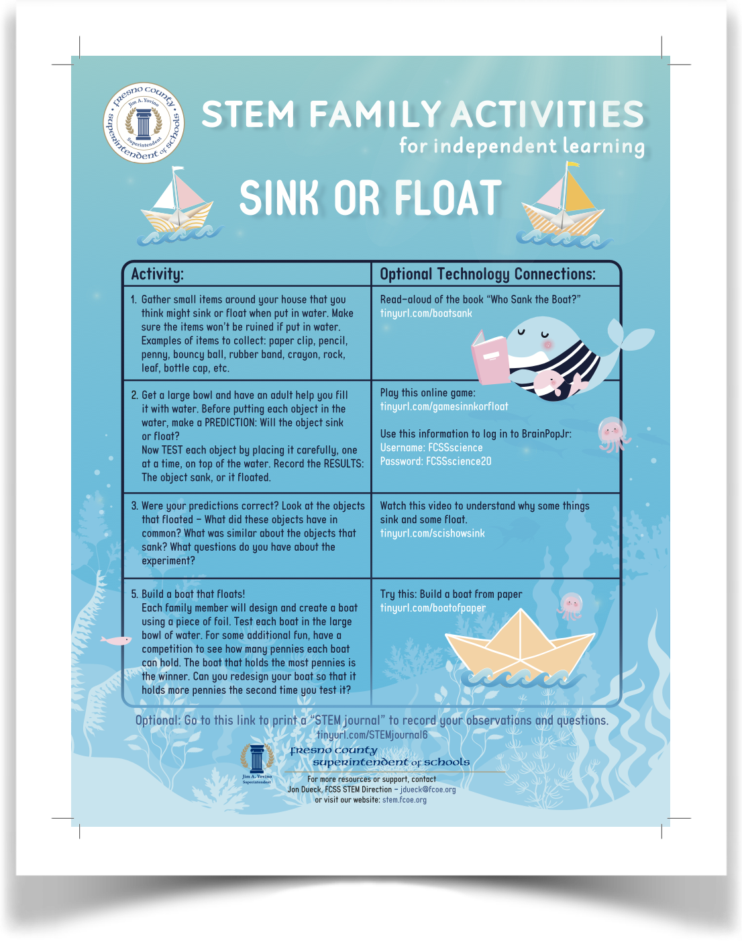
Count Play Explore Issues
Early Math Project
2021

Slide 11
Count Play Explore Issues
Age Ranges
Babies Kindergarteners Toddlers Elementary School Kids
Preschoolers
Early Math Project
2021

Slide 12
Activity Time! Let’s try it out
Sort It Out!
We will be sharing at this Padlet Link:
xxx
Early Math Project
2021

Slide 13
Using Padlet

Slide 14
Early Math Project
2021

Slide 15
Reflection

Slide 16
Using EMP and Initiative Resources
Early Math Project
2021

Slide 17
Newsletters and At Home Activities
Share Count Play Explore Issues with families
Provide Literature Reviews and links to online stories
Send home a weekly activity
Share I’m Ready! videos - ask what they inspired
How would you use them? padlet link
Early Math Project
2021

Slide 18
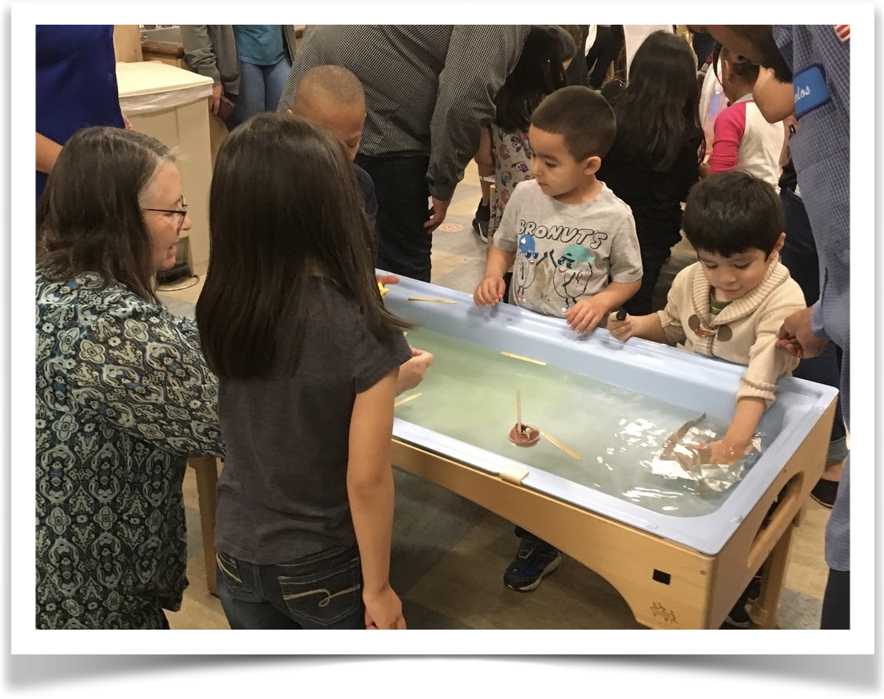
Family Math Events
Planning
Set up
Staffing considerations
EMP Math Festival Resource
Early Math Project
2021

Slide 19
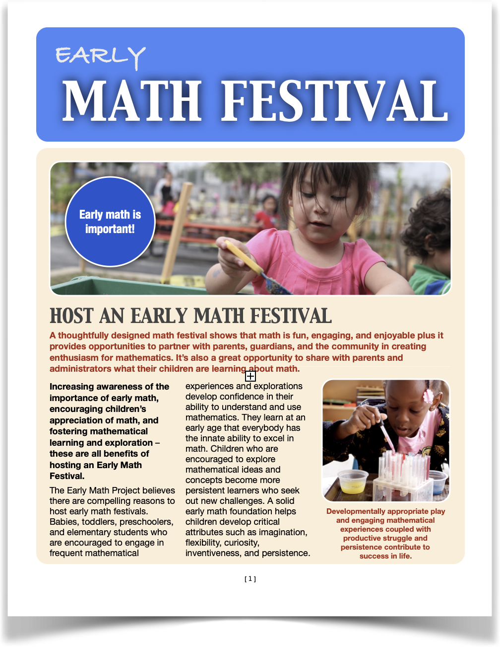
Virtual and Hybrid Family STEAM Events
Set Up
Materials
Free and found objects
Other materials - distribution and return
Online resources
Creating community
How would you use them? padlet link
Early Math Project
2021

Slide 20
Creating Community with Displays
Interactive displays
Family engagement boards
Padlets
In person and virtual sharing
Early Math Project
2021

Slide 21
Early Math Project
Website: www.earlymathca.org
Twitter: @EarlyMathCA
Facebook: Early Math Project
Instagram: earlymathproject
App: CountPlayExplore.org
Email: EarlyMathCA@gmail.com
Early Math Project
2021

