Slide 1
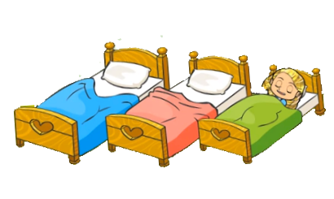
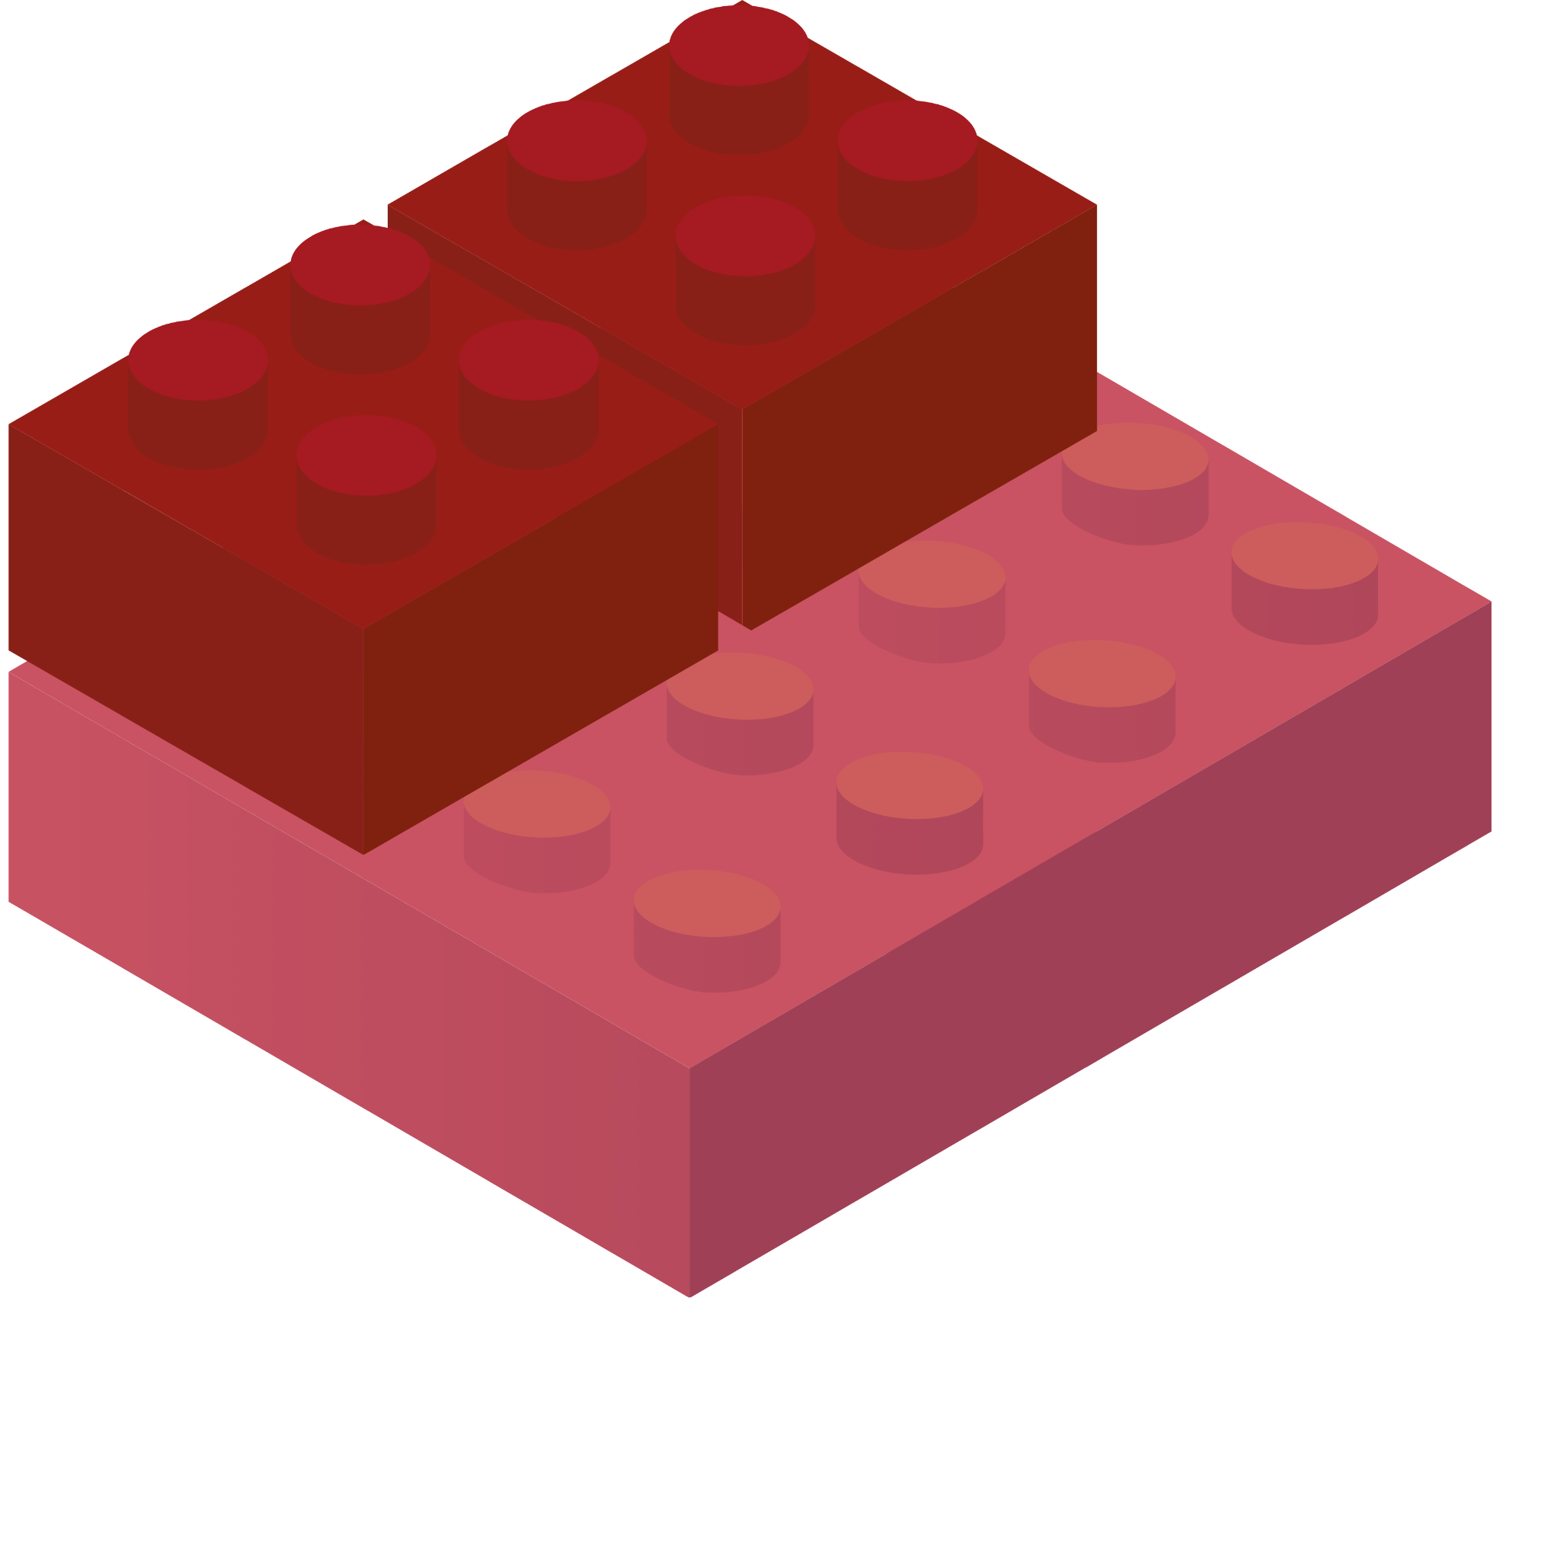
STORIES WITH BRICKS
GRADES PK-4
MATERIALS
LEGO® or DUPLO® blocks
The Three Little Bears (book or video) or a different story
PLAY
Read or watch The Three Little Bears. Children can enact the story and build objects from the story. Ask questions about the story and their playful building?
CREATE
Using the LEGO blocks create a bed. Ask the child to create one as well. Ask, “Are the beds the same? How are they the same? Now let’s make a bed for all the bears.”
OBSERVE
Attend to what child notices as they build the objects. What strategies and tools do they use in their creating. If they don’t have the same pieces can they substitute pieces that create the same object?
KEY CONCEPTS Algebra Concept: Equality When students compare their bed (object) to their teachers, they are exploring the concept of equality. Algebra Concepts: Substitution Substituting blocks when you don’t have the same blocks allows students to see different ways to make the same blocks. Number Sense: Multiplicity As students build multiple beds or chairs, they are experiencing multiplicative thinking. | QUESTIONS TO ASK What did you build from the story? Can you make a bed or chair like mine? How else can you make a bed? chair? What color is on the top/bottom? How many LEGO blocks did you use? Is there a lego you can’t see when you look from the top or the side? | THINGS TO NOTICE Child’s ability to observe the bed or chair. Child’s interest in copying or making something different. What strategy are they using to build? Can they make one that is the same or equal? RESOURCES Goldilocks and the Three Bears - English
@AIMSED
@AIMSCENTER
AIMSCENTER.ORG

Slide 2
CUENTOS CON BLOQUES
GRADOS PK-4
MATERIALES
LEGO® o DUPLO® bloques
Ricitos de Oro y los Tres Osos (libro o video) o una cuentos diferente
JUGAR
Read or watch The Three Little Bears. Children can enact the story and build objects from the story. Ask questions about the story and their playful building?
CREAR
Crea una cama con los bloques LEGO. Pedir al niño que cree uno también. Pregunte: “¿Son iguales las camas? ¿En qué se parecen? Ahora hagamos una cama para todos los osos ".
OBSERVER
Observe lo que nota el niño mientras construye los objetos. ¿Qué estrategias y instrumentos utilizan en su creación? Si no tienen las mismas piezas, ¿Pueden sustituir piezas que creen el mismo objeto?
CONCEPTOS CLAVES Algebra Conceptos: Equality When students compare their bed (object) to their teachers, they are exploring the concept of equality. Algebra Concepts: Substitution Substituting blocks when you don’t have the same blocks allows students to see different ways to make the same blocks. Number Sense: Multiplicity As students build multiple beds or chairs, they are experiencing multiplicative thinking. | PREGUNTAS QUE HACER ¿Qué construiste a partir de la cuento? ¿Puedes hacer una cama o una silla como la mía? ¿De qué otra manera puedes hacer una cama? ¿silla? ¿De qué color está en la parte superior? Inferior? ¿Cuántos bloques usaste? ¿Hay algún bloque que no puedas ver cuando miras desde arriba o de lado? | COSAS A NOTAR Capacidad del niño para observar la cama o la silla. El interés del niño en copiar o hacer algo diferente. ¿Qué estrategia están usando para construir? ¿Pueden hacer uno que sea igual? RECURSOS Ricitos de Oro y los Tres Osos - Español
@AIMSED
@AIMSCENTER
AIMSCENTER.ORG

