Slide 1
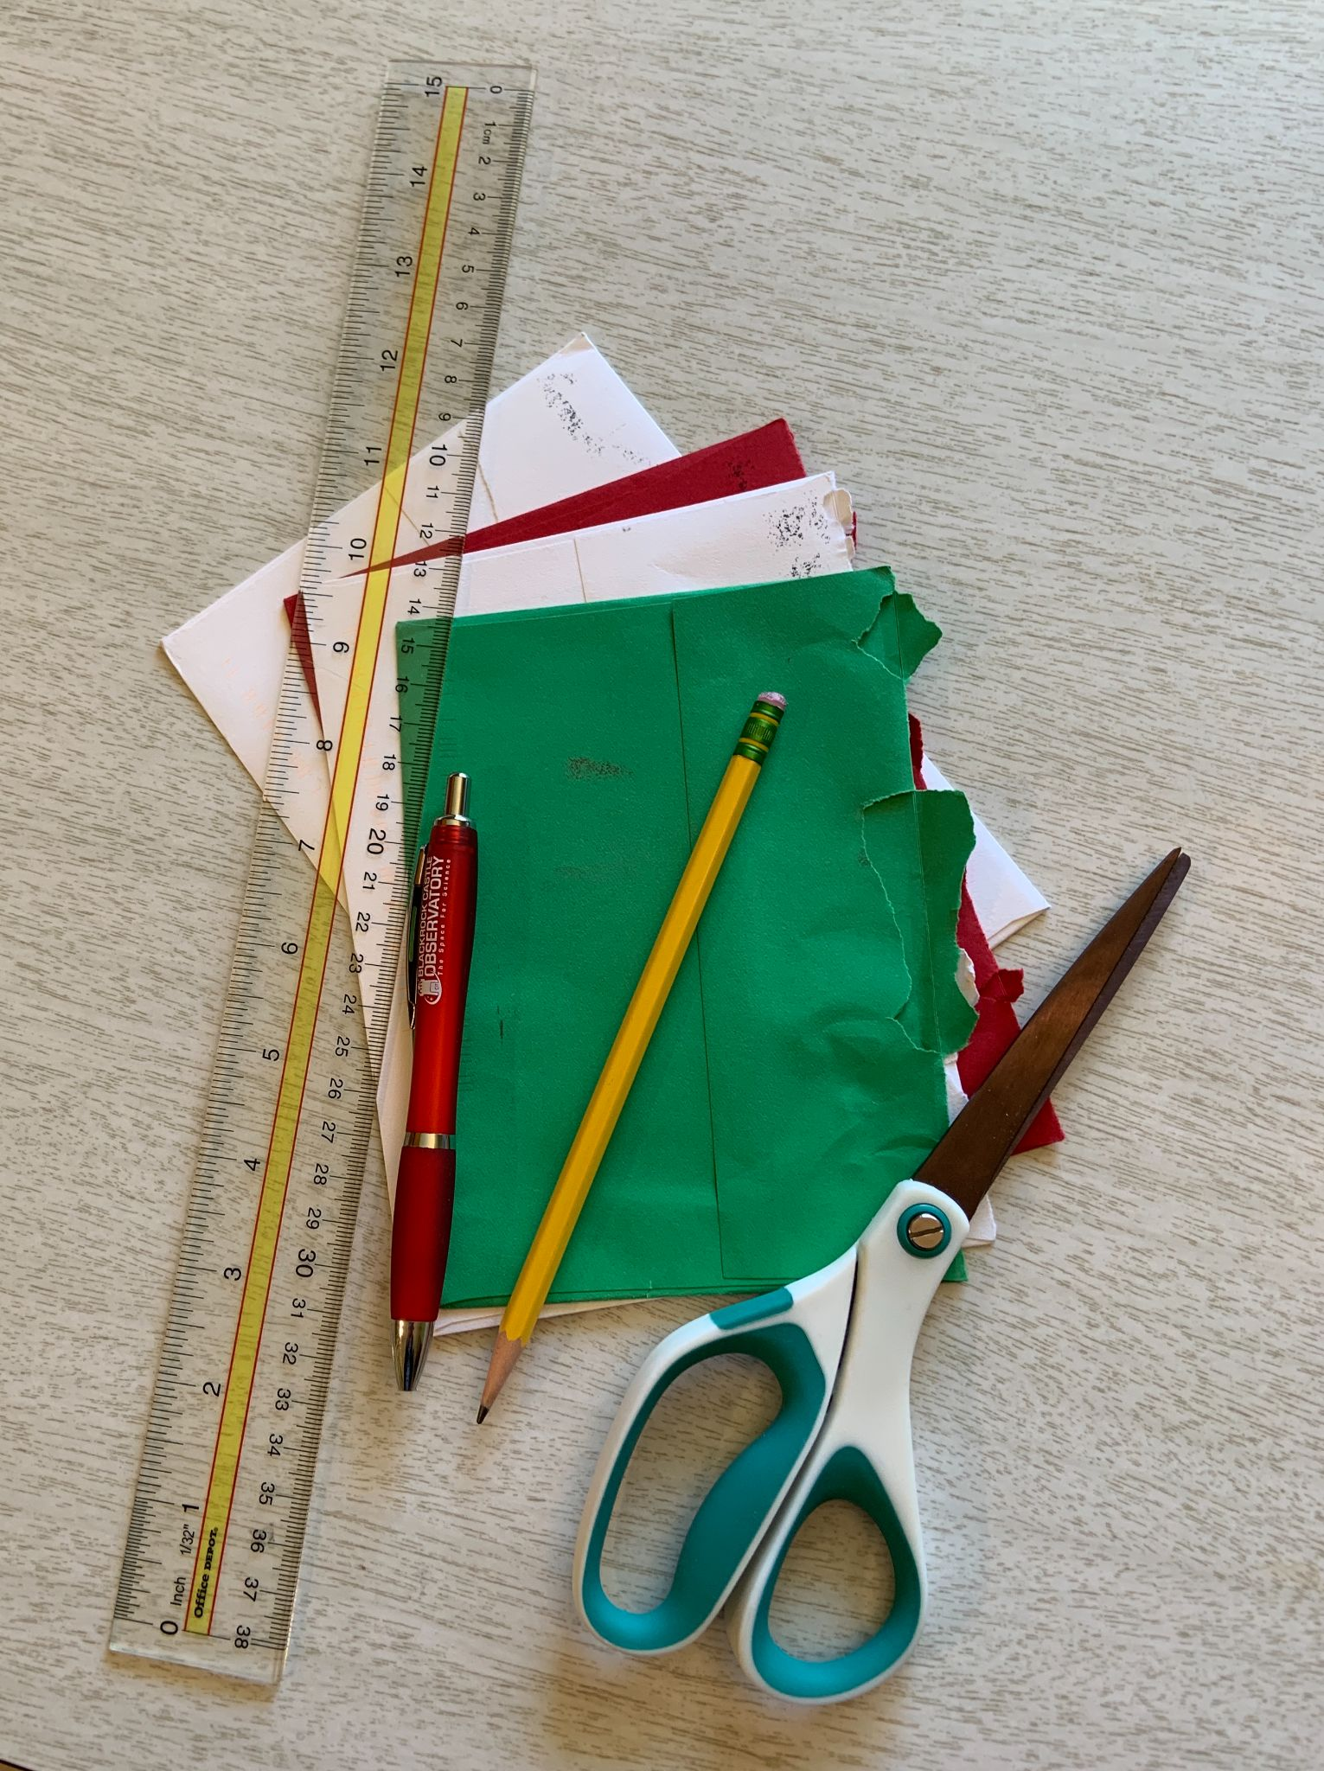
Paper Engineering Magic!
PLAY BREAK
Aileen Rizo, Associate Director, AIMS
Elin Anderson, PK-12 Coordinator, AIMS

Slide 2
OUR VALUES
INCLUSIVITY
EMPOWERMENT
COLLABORATION
HUMAN-CENTERED
INNOVATION
DIVERSITY

Slide 3
MATERIALS NEEDED
2-3 envelopes of various sizes
Pen or pencil
Ruler or straight edge
Scissors

Slide 4
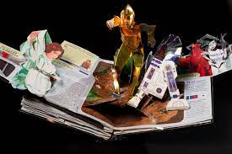
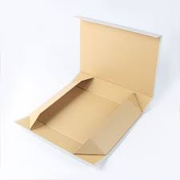
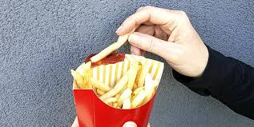
EXAMPLES OF PAPER ENGINEERING

Slide 5
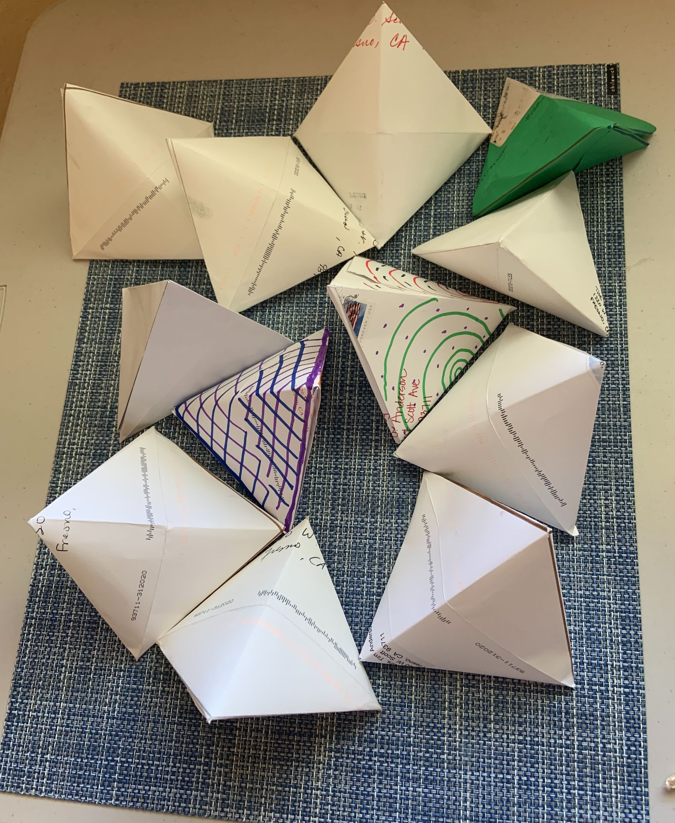
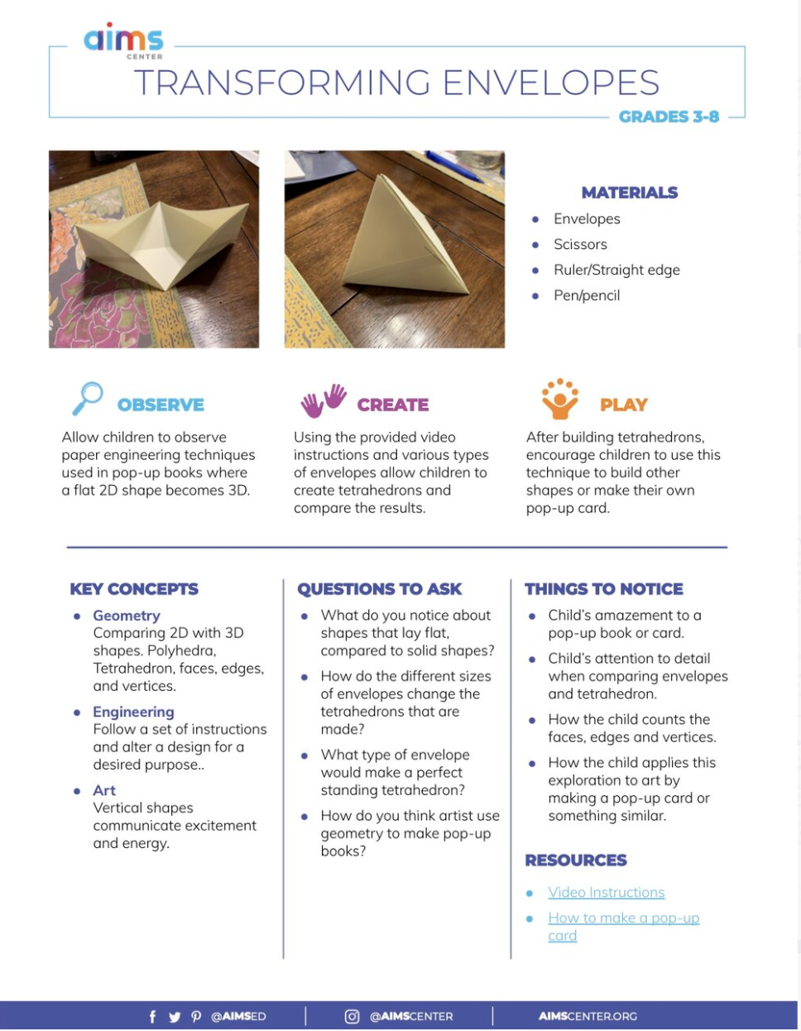
IRREGULAR TETRAHEDRON

Slide 6
PULL UP POLYHEDRA

Slide 7
JOIN US!
Next series of free Hands ONline webinars starting in August:
aimscenter.org/online-learning

Slide 8
THANK YOU!
Aileen Rizo
Associate Director
aileen@AIMScenter.org
Elin Anderson
PK-12 Coordinator
elin@AIMScenter.org
RESOURCES
AIMSCENTER.ORG
Notes:
Introduction - a bit about the AIMS Center and our current work

