Slide 1
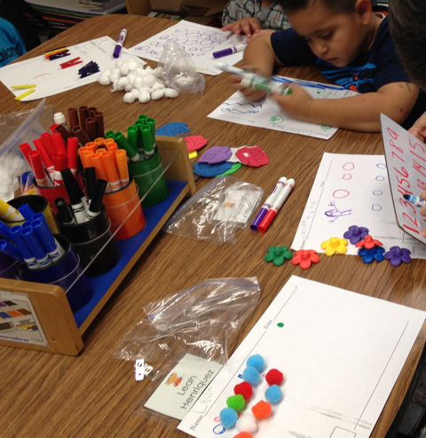
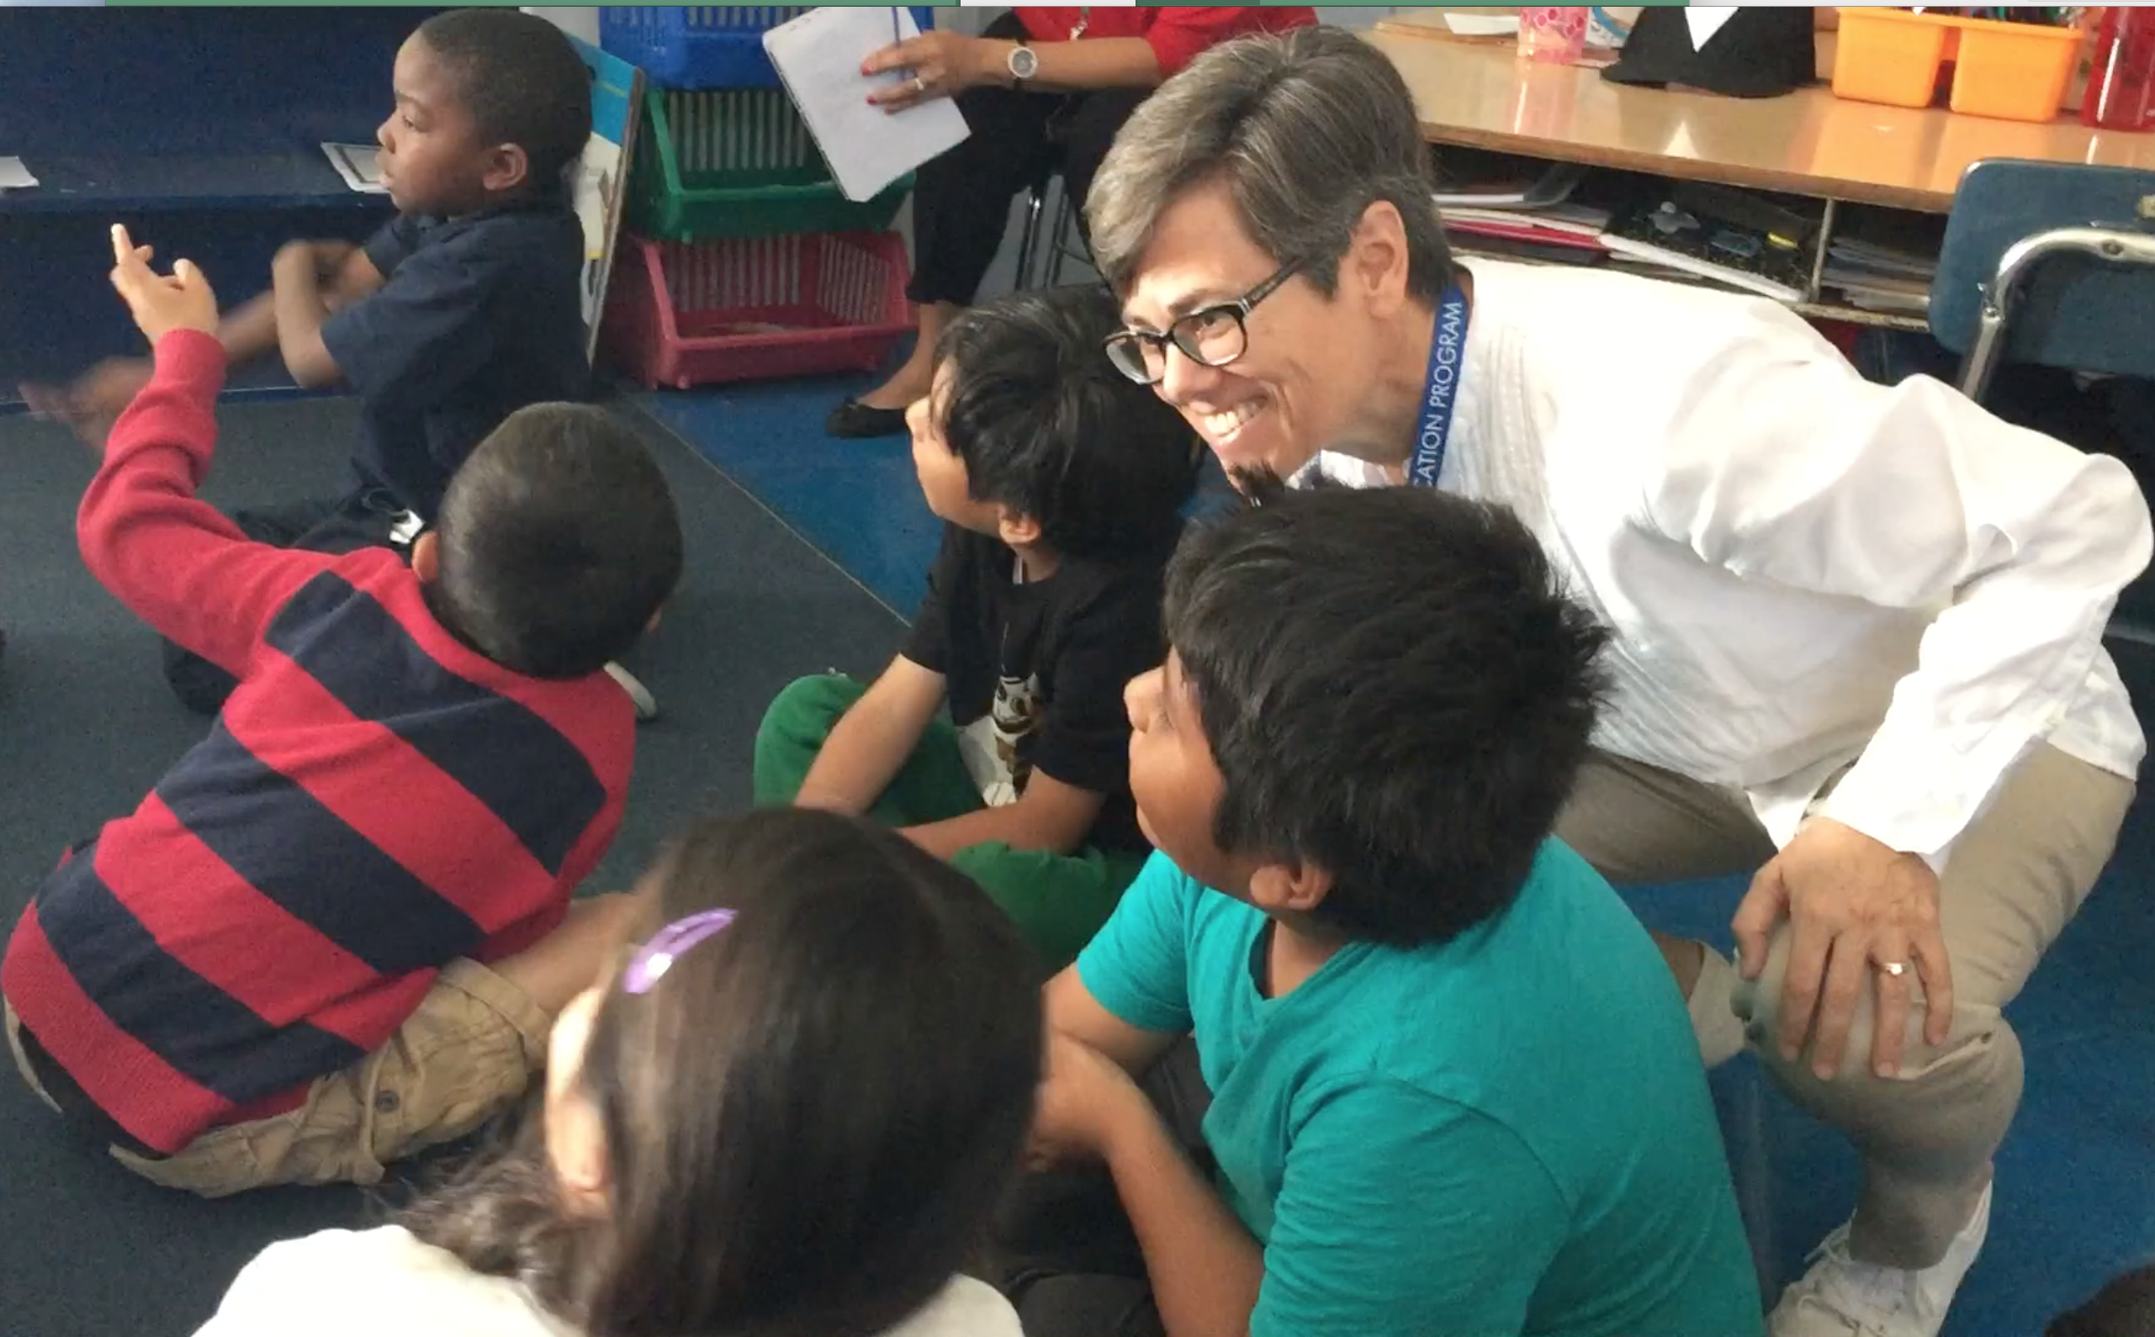
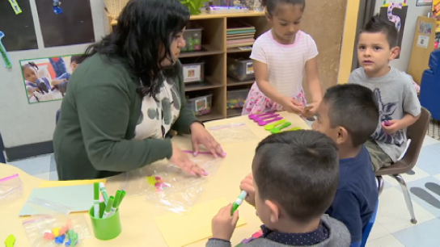
Supporting the Mathematical Brilliance of Young People
Megan Franke

Slide 2
Notes:
Annanta shares tops

Slide 3
Notes:
Jayden Preschooler – 4 JCU

Slide 4
Megan had 3 packages of cupcakes. There were 4 cupcakes in each package.
She ate 5 cupcakes. How many cupcakes are left?
Notes:
Hazel

Slide 5
Notes:
Ferni

Slide 7
Creating opportunities for children’s understandings to emerge
Details matter
  Research on children’s mathematical thinking can help us to know what to look and listen for—to uncover children’s rich intuitive ideas about mathematics (Carpenter et al., 2017; Empson & Levi, 2013)
Informal knowledge matters
  Look for understandings of sophisticated mathematics within informal language, representations, and gestures (Moschkovich, 2013)

Slide 8
Capturing what children know and can do
Tasks matter:
  Tasks that “problematize” the mathematics can create opportunities to learn about children’s emergent understandings (Hiebert et al., 1996)
Partial understandings matter:
  Attending to the details of children’s thinking allows us to recognize the productive mathematics within incorrect or in-process responses
  All-or-nothing approaches to assessment are likely underestimating young children’s capabilities (Franke et al., in press; Johnson et al., 2019)

Slide 9
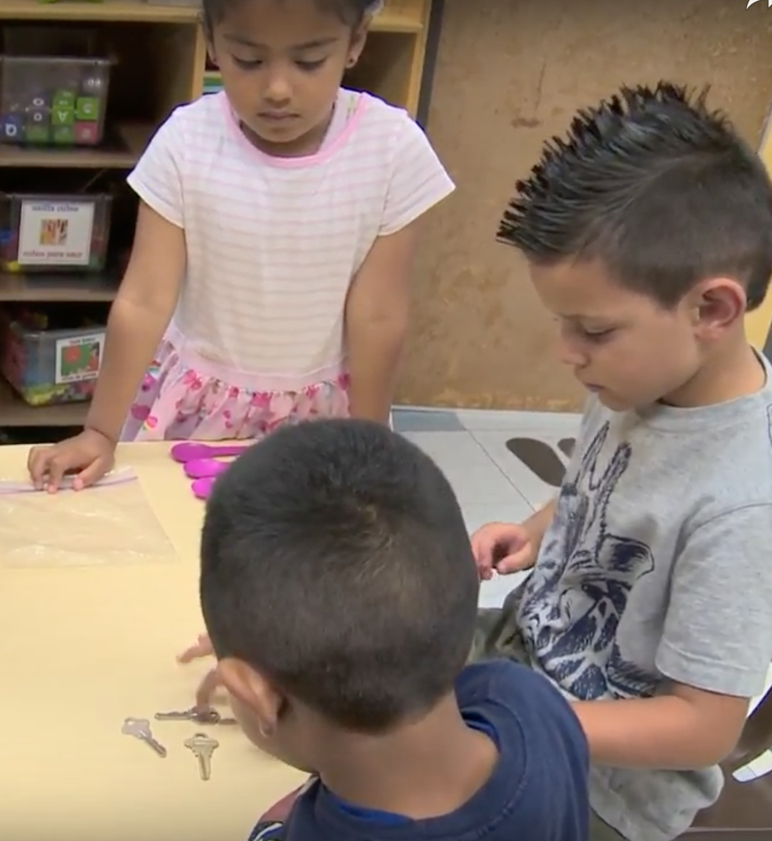
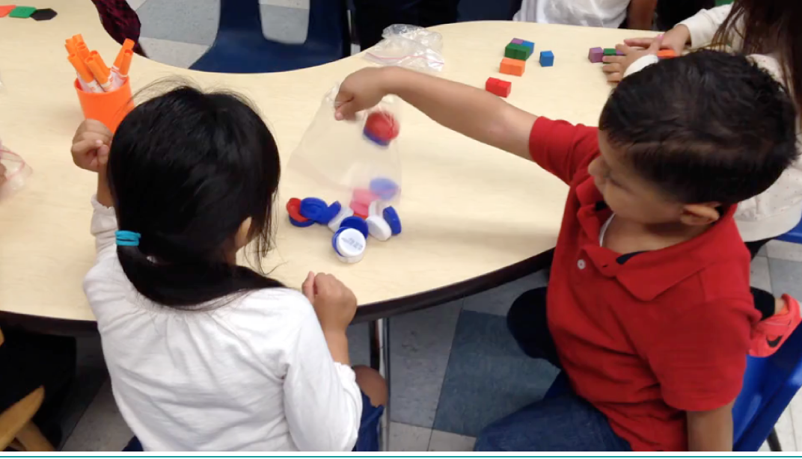
And… Learning is a collective endeavor

Slide 10

10 + 10 + 14 = 34
Notes:
the math practices in relation to t/f and algebraic thinking. These Kindergartners all explain their ideas.
Maybe not use. Nice around MPs
Adriana Mackavoy

Slide 11
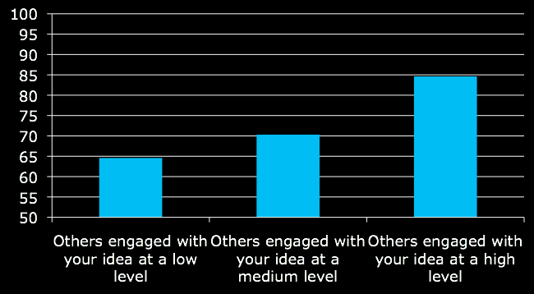
Relationship between Others Engaging with Your Ideas and Achievement
general reference
detailed reference, nothing new
detailed reference, contribute new idea
Notes:
Same for you engage with another’s idea

Slide 12
What does EOI sound and look like?
Details and specificity matter when it comes to explaining your ideas and engaging with the ideas of others
It’s not just about getting students to talk… it’s about getting into the substance of their math ideas
It’s doesn’t need to sound pretty / use formal vocabulary / happen all at once
Partnering students is about the students and their feelings about engaging with others

Slide 13
Participation Varies Across Students
With Same Achievement Score
Notes:
If we only create one kind of opening – or support it in one way – only some students will be able to participate..what you do matters
Students choose, when on their own without the teacher, their own ways of engaging (don’t all use the teachers ways or the same way)

Slide 14
How much explanation occurs before others demonstrate engagement?
Complete | 27%
Partial | 63%
others engage before any explanation | 10%

Slide 15
Supporting Engaging with Others Ideas
When questions were broad/general students hesitated, but when questions were more specific and when T positioned them as being correct before asking the to explain/justify they participated (Parks 2010 found this to be true in her study of Black students)
Supporting EOI involves helping students figure out how to do it – in the moment – and then explicitly recognizing it when they take it up
Supporting EOI involves positioning students competently (Johnson et al)
Supporting EOI involves building relationships with students (Battey et al)
Notes:
Teacher/student relationship is related to who and what gets recognized as a math contribution

Slide 16
“How teachers speak, listen, see, and interact with young people matters. They shape the environment and interactions that in turn shape students’ sense of themselves and their competence. Teachers can reproduce themselves and their competence. Teachers can reproduce marginalization or disrupt it. As such, they play an essential role in rehumanizing school experiences of Latinx, Black, and indigenous students.”
-Professor Imani Goffney
Participation and Teaching

Slide 17

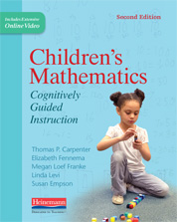
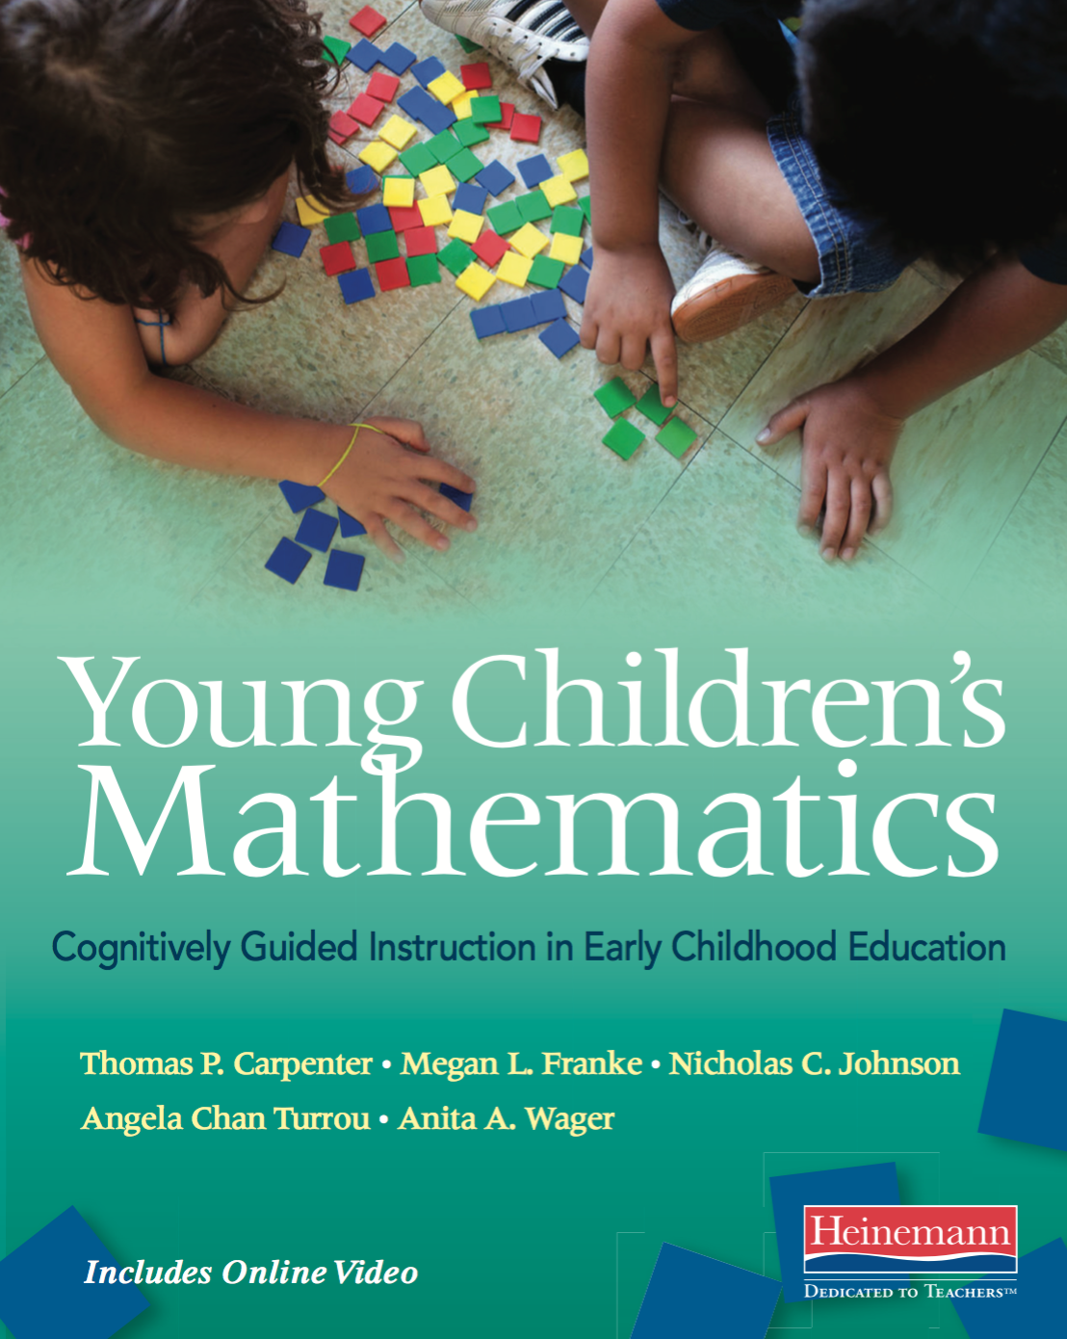
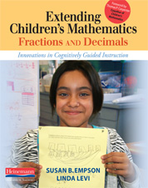
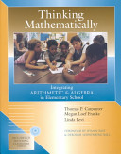

Resources for teachers and teacher educators
DREME TE website
http://prek-math-te.stanford.edu/
Cognitively Guided Instruction books
  Children’s Mathematics
  Extending Children’s Mathematics
  Young Children’s Mathematics
  Thinking Mathematically
#CGImath
@megnlfranke

